Slide 1

PRESENTED BY: AslinDhurai C REGISTER NO: 962821104013 DEPT: COMPUTER SCIENCE AND ENGINEERING NM ID: au962821104013 EMAIL ID: aslindhurai1@gmail.com
Convolutional Variational Autoencoder (CVAE)

Slide 2

PROJECT TITLE
Fashion MNIST Image Generation using Convolutional Variational Autoencoder (CVAE)

Slide 3


AGENDA
,
Introduction
Problem Statement
Project Overview
End Users
Wow in our solution
Modeling
Evaluation
Conclusion
3/21/2024 Annual Review

Slide 4
INTRODUCTION
In the fashion world, creativity is key. Our project uses fancy technology to make new fashion pictures. We're focusing on a special kind of computer program called a Convolutional Variational Autoencoder (CVAE). We're using a bunch of pictures of clothes called the Fashion MNIST dataset to teach the program. Our goal? To make the program learn how to create its own cool fashion images. By using smart computer tricks like deep learning, we want to change how people think about making clothes. We hope our project will inspire new ideas and ways to design fashion using computers.

Slide 5

PROBLEM STATEMENT
Fashion MNIST dataset is a popular benchmark dataset consisting of grayscale images of various fashion items. The task is to develop a model capable of generating new fashion images resembling those in the dataset.

Slide 6

PROJECT OVERVIEW
In this project, we aim to implement a Convolutional Variational Autoencoder (CVAE) using TensorFlow. The CVAE will be trained on the Fashion MNIST dataset to learn a latent representation of the images. Once trained, the model will be able to generate new fashion images by sampling from the learned latent space.

Slide 7

WHO ARE THE END USERS?
Fashion designers looking for creative inspiration and new design concepts.
Fashion retailers interested in generating unique product variations and collections.
Researchers and practitioners in the field of artificial intelligence and machine learning exploring generative modeling techniques.
Students and educators teaching and learning about the intersection of fashion and technology.
Creative individuals and hobbyists interested in exploring the potential of computer-generated fashion designs.

Slide 8
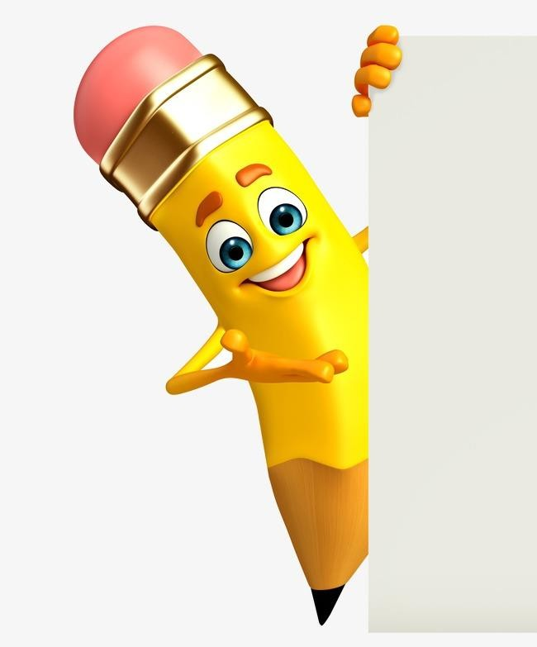
YOUR SOLUTION AND ITS VALUE PROPOSITION
Our Solution:
Convolutional Variational Autoencoder (CVAE): Utilizes deep learning to learn a latent representation of Fashion MNIST images and generate new fashion items.
Value Proposition:
Realistic Image Generation: Our solution generates realistic fashion images that closely resemble those in the dataset, offering high-quality outputs.
Applications Across Industries: From fashion design to retail, our solution has diverse applications, catering to a wide range of industries interested in image generation and creative exploration.
Deep Learning Expertise: Leveraging deep learning techniques, our solution demonstrates expertise in learning intricate patterns and styles from complex datasets, showcasing advanced capabilities in generative modeling.

Slide 9

THE WOW IN YOUR SOLUTION
Generate realistic fashion images from learned latent space
Create diverse fashion items with variability in generated images
Potential applications in fashion design, retail, and creative industries
Utilizes deep learning to learn intricate patterns and styles
3/21/2024 Annual Review
9

Slide 10
Autoencoder Architecture:
Chosen for its ability to learn compact representations of data.
Designed to efficiently encode and decode input fashion images.
Data Preprocessing:
Essential for enhancing data quality and model robustness.
Techniques like normalization ensure uniformity across features.
Image resizing and augmentation increase dataset diversity.
Training Process:
Dataset partitioned into training and testing sets for accurate evaluation.
Model parameters initialized; optimization algorithms selected.
Optimization of training iterations and batch sizes for improved convergence and efficiency.
MODELLING
10

Slide 11
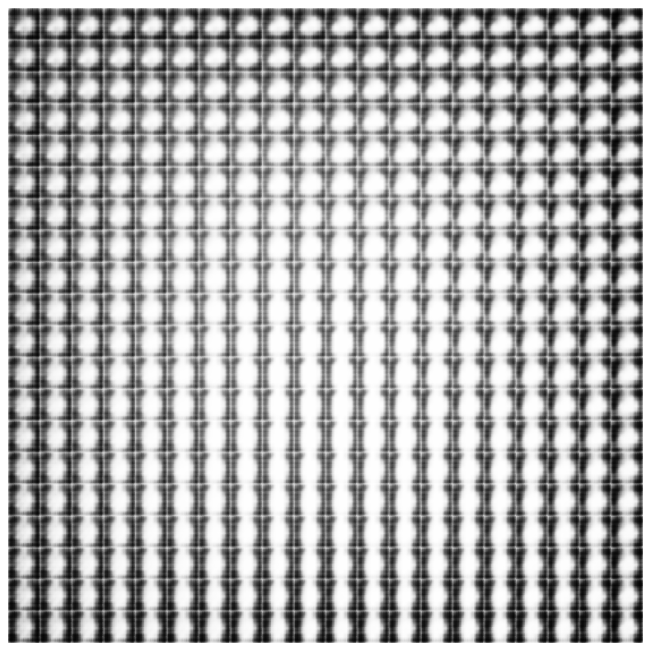
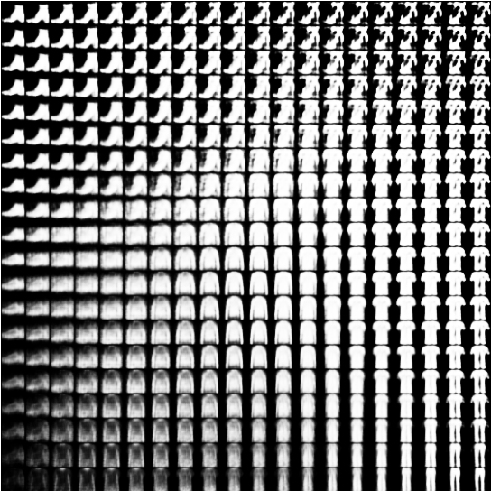
Evaluation
11

Slide 12
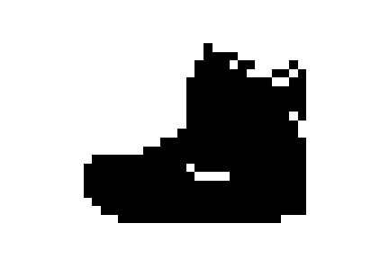
GIF Animation

Slide 13
Conclusion
Our project showcases the power of Convolutional Variational Autoencoders (CVAEs) in generating realistic fashion images.
Through meticulous data preprocessing and model optimization, we've created a robust and efficient solution.
The Autoencoder architecture efficiently learns compact representations of fashion data.
Our model captures the essence of fashion images while minimizing information loss.
By bridging creativity and technology, we aim to inspire innovation in fashion design.
We envision a future where art and technology redefine the fashion landscape.

Slide 14
THANK YOU

